Slide 1


Chinook Music Store Analytics
Data Driven exploration of Customer Behavior and Sales
Shreyas Goyal
20/09/2024

Slide 2
Problem Statement
01
Chinook Music Store is a leading provider of music records with a diverse range of genres and albums.
Committed to customer satisfaction.
Offers a curated collection of popular artists, classic albums, and niche genres.
A go-to destination for music enthusiasts worldwide.
How can Chinook Music Services leverage customer data to identify key trends, optimize product offerings, and improve marketing strategies in order to maintain its position in the competitive physical music market?
About
02
Problem Statement
03

Slide 3


GOALS AND OBJECTIVES
1
Analyze customer purchasing behavior.
Identify customer preferences and trends in terms of genres, artists, and albums.
Analyze the impact of factors like price, release date, and promotions on customer purchasing decisions.
Identify customer segments with high potential for growth or retention.
Identify growth opportunities and optimize marketing efforts to drive sales.
Develop personalized marketing campaigns based on customer preferences and purchase history.
Ensure and enhance and customer satisfaction and loyalty.
2
Goals
3
4
5
6
7
Through meticulous data exploration, we’ll be guiding Chinook towards customer retention strategies and promoting advertising in the regions with the most potential for a flourishing.

Slide 4

Understanding our Store Landscape
01
02
03
04
Attributes
Data Importance
Key Data Points
Data cleaning and missing values
Total Tables: 11
Table: 20 employee, customer, invoice, invoice_line, track, album, genre, media_type, playlist_track, artist, playlist
Country Description: 2 (CountryCode, Country Name) 24 different countries
Tracks sold are of 25 different genres
Invoice table to incluse all transactions
This data is critical for analyzing trends in the music sales across different countries.
Examining factors like total , number of customers, churn analysis, and risk and customer lifetime value.
We can identify potential loyal customers and increase customer engagement.
Countries: Data includes sales from various countries.
Ratings: Average rating can help identify customer satisfaction levels.
Price (total): Sales is the measure on which we can analyse different dimensions.
Genre, artist, albums: Shows the customer preferences.
Invoice DAte: Indicates purchasing patterns with time.
Data Cleaning:
No duplicates (0 found)
Addressed missing values:
Replaced blank states in State column with “other” in some queries

Slide 5





Analytical approach
Understanding the Data
Familiarize with the tables, columns and relationships
Assess Data Quality
Check for missing values and inconsistency and redundancy
Write SQL Queries
Start with simple queries to retrieve basic info and gradually build more complex queries as needed.
Relate the finding of queries back to original business problem.
Interpret the results

Slide 6
Demographic Breakdown
Customers are from 24 different countries
Maximum number of customers are from USA(13) and Canada(8)

Slide 7
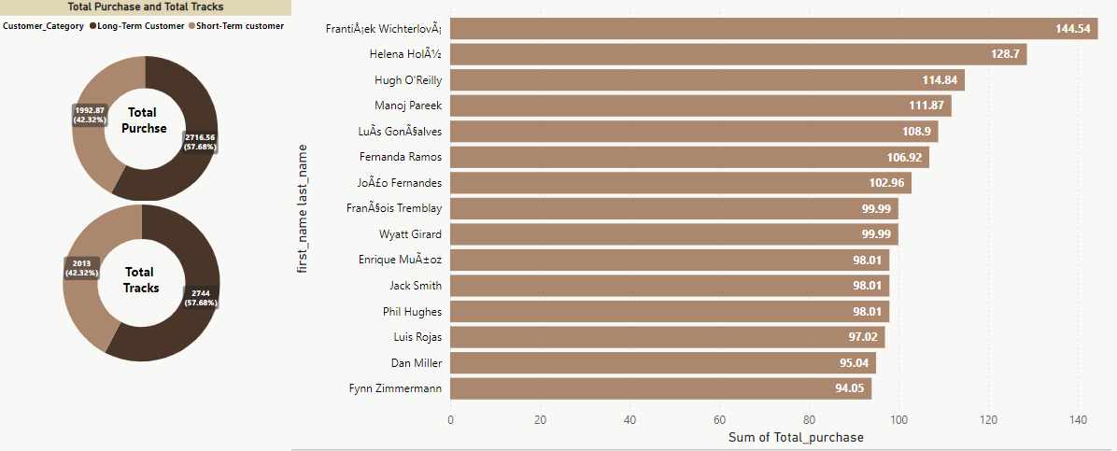
Top Segment Customers
FrantiÅ¡ek Wichterlovský is the top customer by total purchase, followed by Helena Holáková and Hugh O'Reilly and Manoj Pareek.
Long-term customers tend to have higher total purchases and total tracks purchased compared to short-term customers. This suggests that they are more engaged and loyal to the business.
Long-term customers are majorly those who order most frequently and contribute in the top percentile of the revenue, further emphasizing their importance to the business.

Slide 8
Total Revenue
Country | Total Purchase
USA | 1040.49
Canada | 535.59
Brazil | 427.68
France | 389.07
Germany | 334.62
Czech Republic | 273.24
United Kingdom | 245.52
Portugal | 185.13
India | 183.15
Ireland | 114.84
USA Dominates: The USA outperforms in terms of total purchases, highlighting its dominance in the market.
Emerging Markets: Countries like India, Portugal, and Ireland show moderate revenue generation
Developed Markets: European countries, including the United Kingdom, Germany, and France, demonstrate strong revenue generation, indicating a mature and developed music market
STATISTICS
The top 4 countries USA, Canada, Brazil, France account for more than 50% of revenue generation worldwide.
Overall, the data indicates a significant disparity in revenue generation across countries. The USA stands out as the dominant market, while other countries exhibit varying levels of revenue.
The top 4 countries USA, Canada, Brazil, France account for more than 50% of revenue generation worldwide .

Slide 9
% Contribution by each genre in USA
Rock music is the top-selling genre, accounting for a 50% portion of total revenue in USA
Alternative and Punk music genres also have substantial market shares.
Overall, the chart indicates a diverse music landscape with Rock, Alternative & Punk emerging as the leading genres

Slide 10
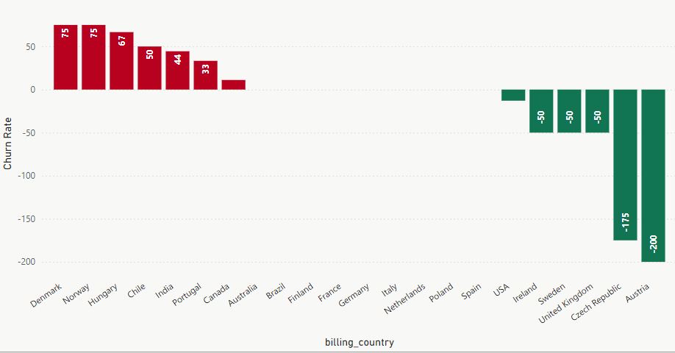
Churn rate across Countries
Denmark, Norway, Hungary, and Chile, India, Canada have the highest churn rates.
The USA, Sweden, Ireland, Czech Republic, Austria and UK, have negative churn rates.
Implement loyalty programs to reward repeat customers and encourage continued engagement.
To optimize sales, we recommend increasing advertising efforts in countries with robust economies and offering more affordable tracks in regions with lower economic indicators.
Positive Churn rate - This suggests that these countries may need to focus on improving customer retention strategies.
Negative Churn rate - These countries have implemented effective customer acquisition and retention strategies.
0 Churn rate - factors a stable customer base, effective marketing strategies, or strong customer loyalty. .

Slide 11
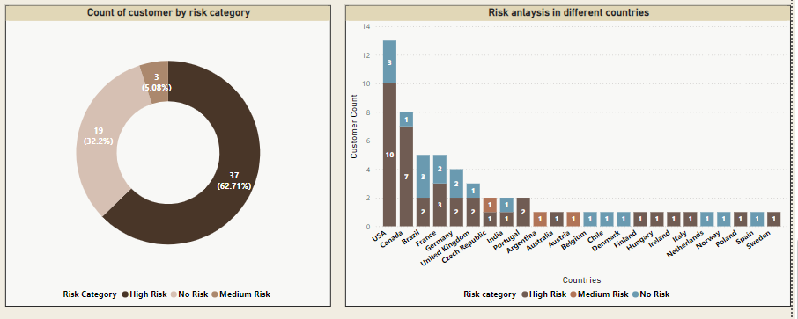
Risk Analysis
Based on the difference values of day since last purchase and average time to reorder, we can categorize customers into different risk levels for churn
62.71% are classified as "High Risk," indicating a high deviation from their expected purchase
5% are categorized as "Medium Risk," suggesting that they may be purchasing slightly less frequently than their average reorder time
32.2% fall into the "No Risk" category, indicating that they are purchasing at a regular frequency and are not at risk of churn
Customer with infrequent purchase or declining purchase are likely at risk
Strong purchase history represent a promising segment for targeted promotions

Slide 12
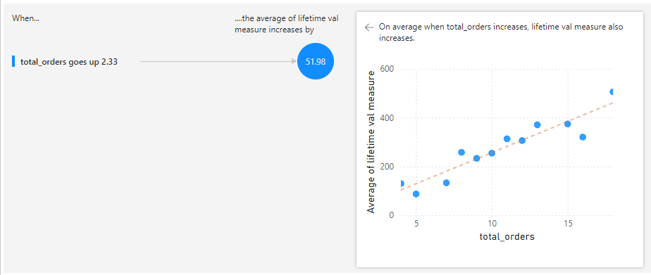
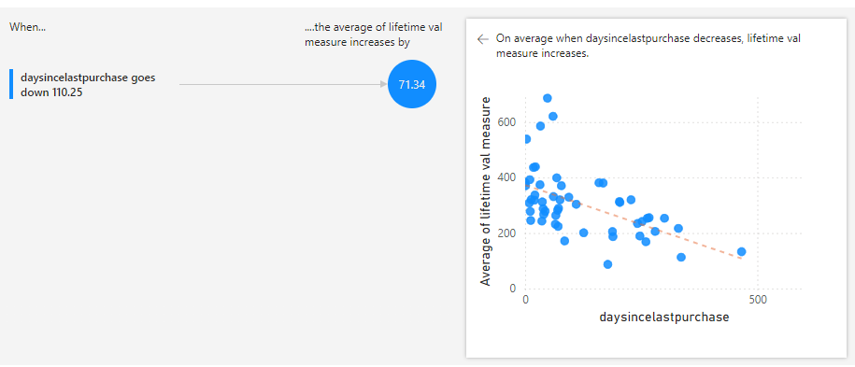
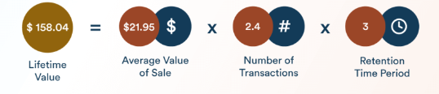
Customer lifetime value
Negative corelation between Daysince last purchase and CLTV. The increase in CLTV (71.34) when "daysincelastpurchase" decreases by 110.25 suggests that a decrease in days since last purchase has a significant impact on CLTV.
Positive correlation between total orders and customers life time value. Significant Impact: The increase in CLTV (51.98) when "total_orders" increases by 2.33 suggests that an increase in total orders has a significant impact on CLTV.
Customer lifetime value Formula

Slide 13
Impact on customer acquisition
Sales Impact: Compare overall sales during and after the campaign to the baseline levels. Analyse which promotional campaigns generated highest sales or return on investment.
Customer retention: Identify customers who have made repeat purchases after attending events or receiving discounts. Analyse change in churn rates before and after the campaign.
Customer acquisition: Compare the number of new customers before, during and after the campaign to the baseline levels. measure effectiveness of email marketing and social media marketing by tracking percentage of recipients who click on links
Customer Segmentation: Analyse impact of campaign on different customer segments – new, existing, high value,

Slide 14

Strategic Recommendation
Strategic Recommendation
Expansion
Promotional Campaign
Customer retention
The Company should concentrate on broadening its offerings to a wider range of countries to expand its customer base. Gain more and new customers in the North and South American Region
The company should concentrate on the US, Canada, Brazil market and implement more promotional campaigns. Increase sales and market penetration in this region
Focus on reducing churn in the countries with the highest churn rates. Specially Europe region. Focus on customer at high risk of churn and short term customer to increase customer retention
Customer Segmentation and Targeting:
Adding feedback mechanism
Stock
Delivering personalized recommendations to enhance the customer experience
Focus on retaining and upselling to customers who contribute significantly to revenue.
Actively seek customer feedback through surveys and reviews to identify areas for improvement.
Focus on retaining and upselling to customers who contribute significantly to revenue.
Ensure a diverse product offering as per the best selling genre, artist, album and maintain high product quality standards. Service to customer based on purchase history

Slide 15
Strategic Recommendation
Expected Outcomes
Outcomes
Outcomes
Outcomes
Increased market Penetration and customer base expansion.
Improved customer satisfaction and retention rates
Higher overall revenue and profitability.

Slide 16
Conclusion
By analyzing music store data, we've identified Customer churn, risk profile and demographics.
USA is the leading country and is where store can focus more
The overall customer churn is 19.44 which can be further reduced by campaigns for customer retention.
The Chinook Music Store has a significant opportunity to expand its market reach and improve customer satisfaction by focusing on targeted marketing, customer retention, and leveraging data-driven insights.
By implementing the recommended strategies, the company can achieve sustainable growth and success in the physical music market.

